Slide 1
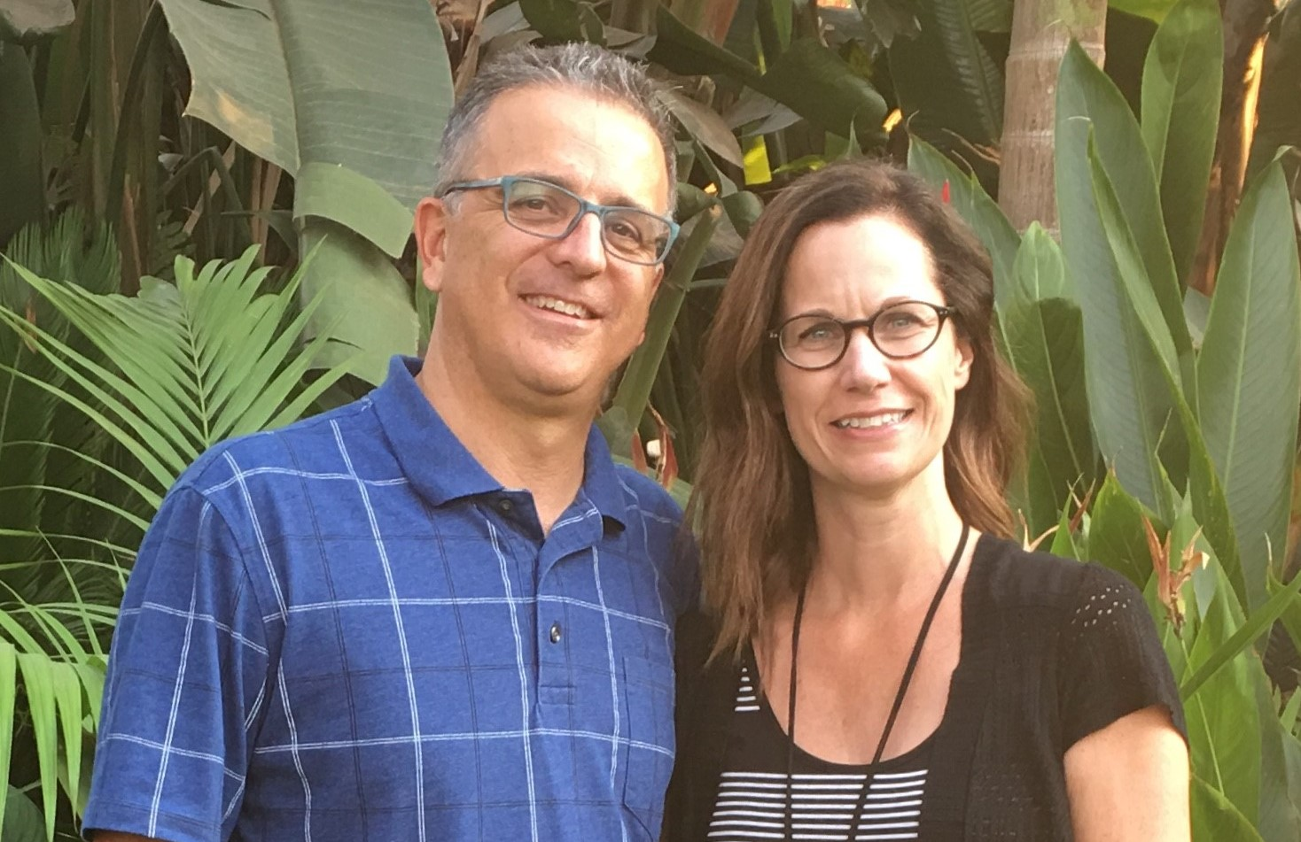
Jerry & Brenda Schuetz
Global outreach & training.
Equipping & deploying global workers.
Scouting new frontiers for pioneer missions.
Poverty intervention & development.
Reaching & Teaching the Nations to Reach & Teach the Nations

